Slide 1
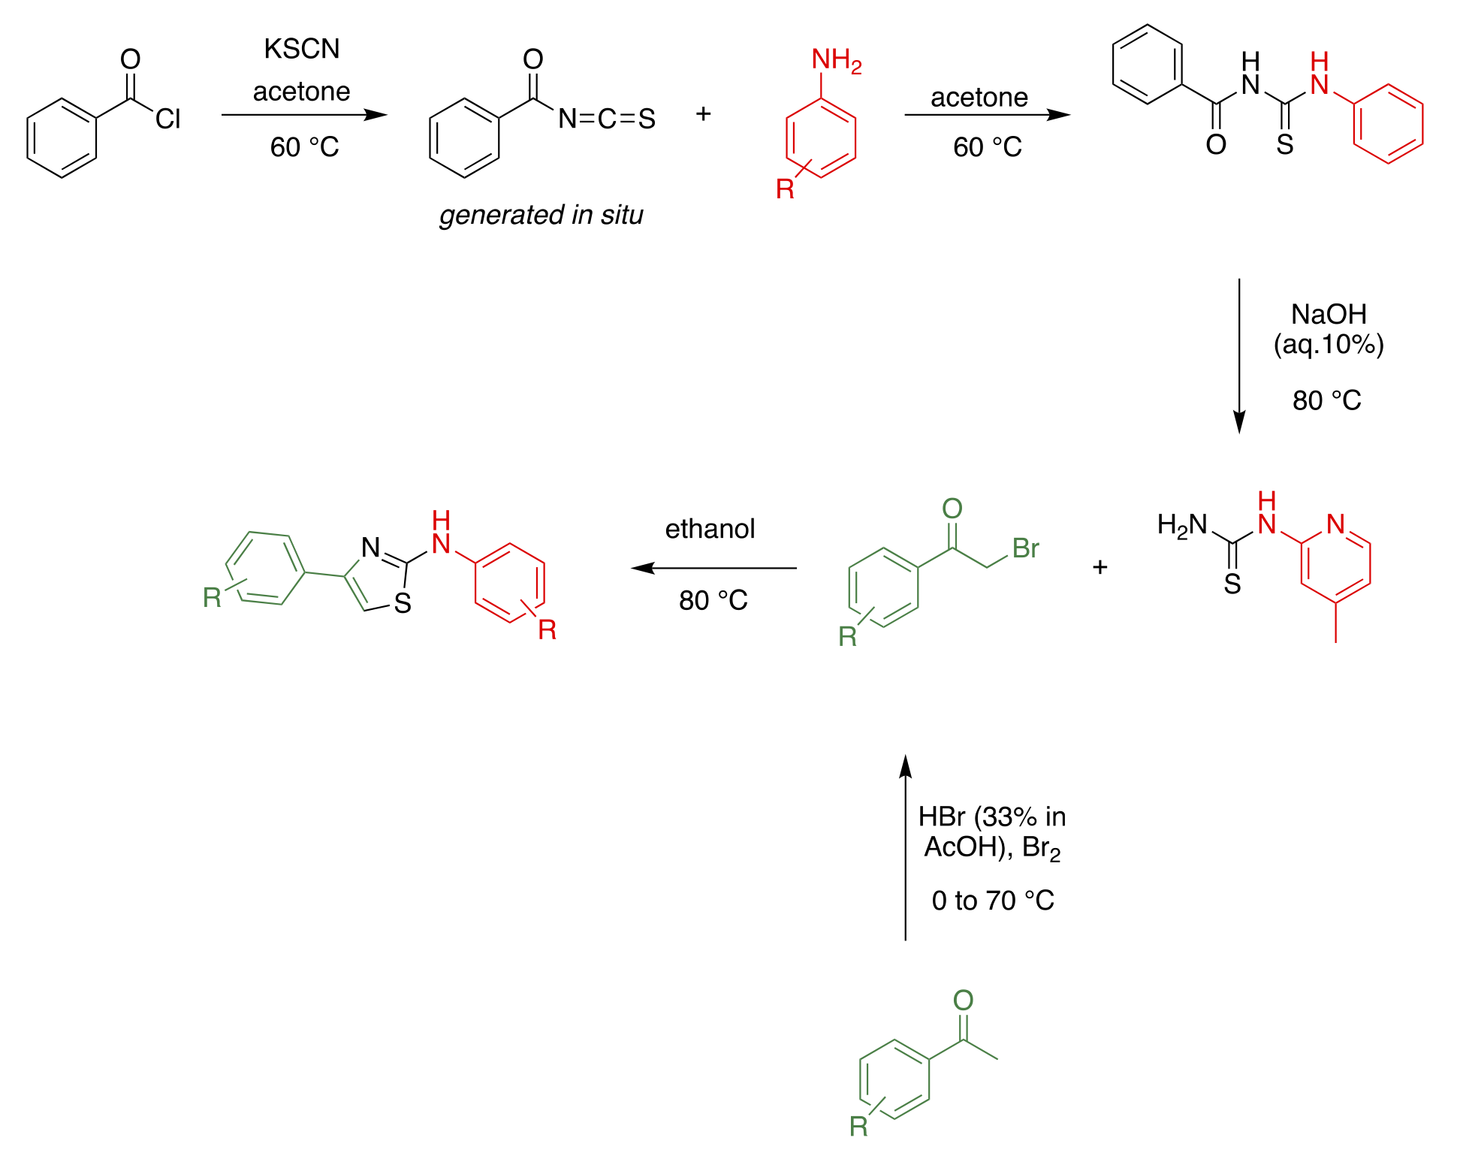
Synthesis Route All Worked Out
https://github.com/OpenSourceMycetoma/Series-2-Aminothiazoles/wiki/General-Synthesis-Route

Slide 2
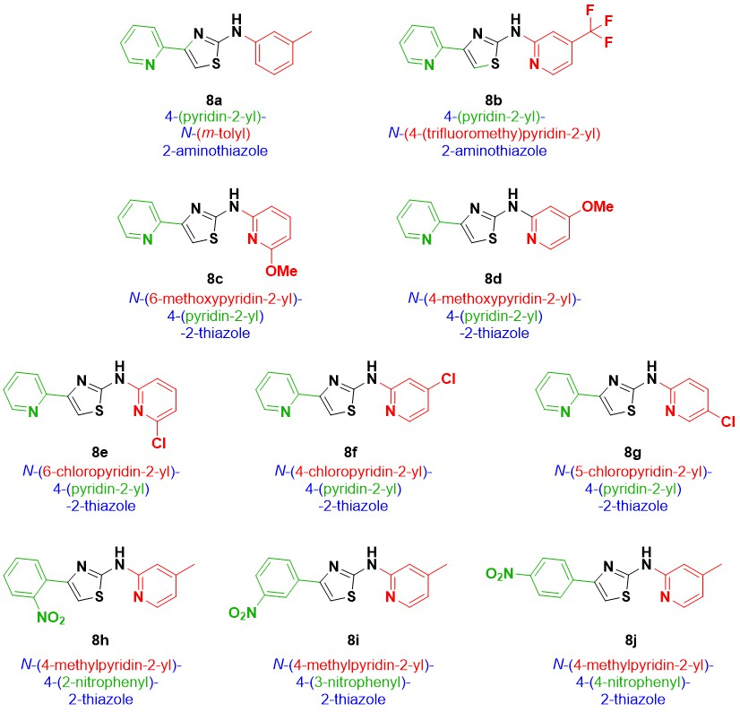
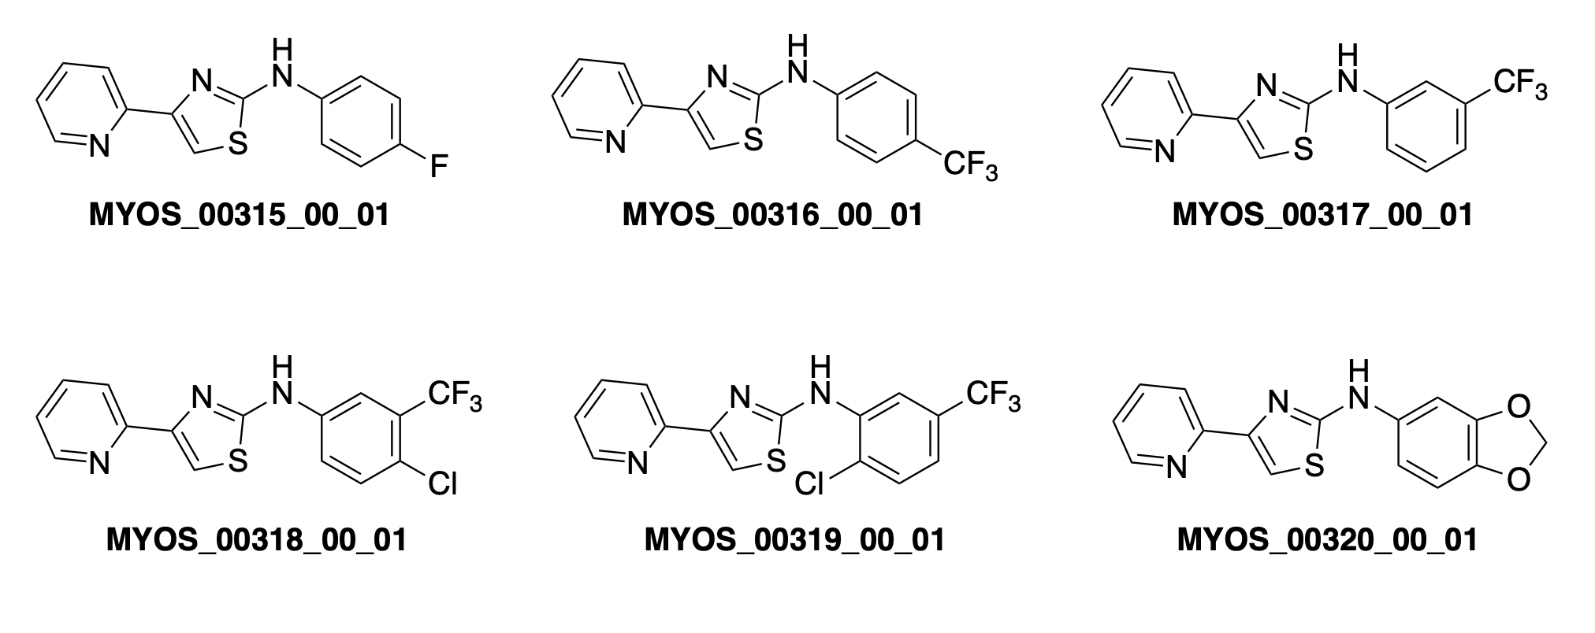
Recently-made Molecules
What should you make?
https://github.com/OpenSourceMycetoma/Series-2-Aminothiazoles/issues/10

